Slide 1
Why Smart People
Make Weird Money Decisions
Three forces
What feels right in the moment
Instincts
Probability
How we misread risk, odds, and streaks
Core question
If people are predictably human with money, can those mistakes move markets?
Emotion
Why gains and losses feel different
Notes:
We will start from your instincts, then connect them to the rational benchmark, behavioral biases, and investor behavior.

Slide 2
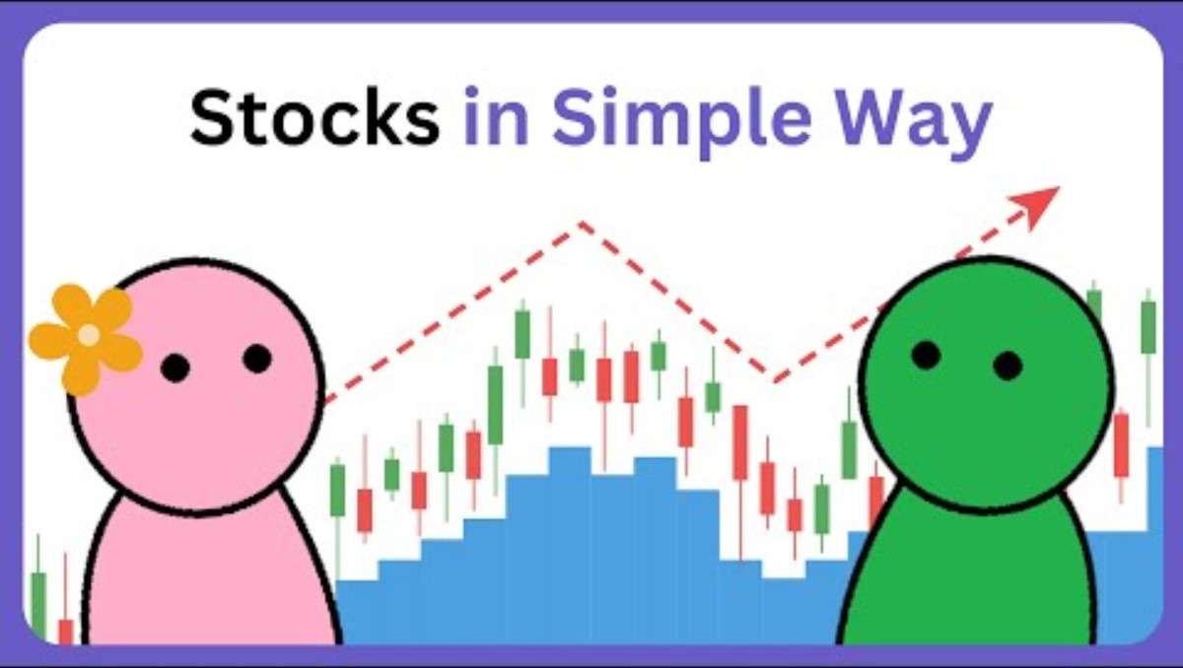
What is stock?

Slide 3
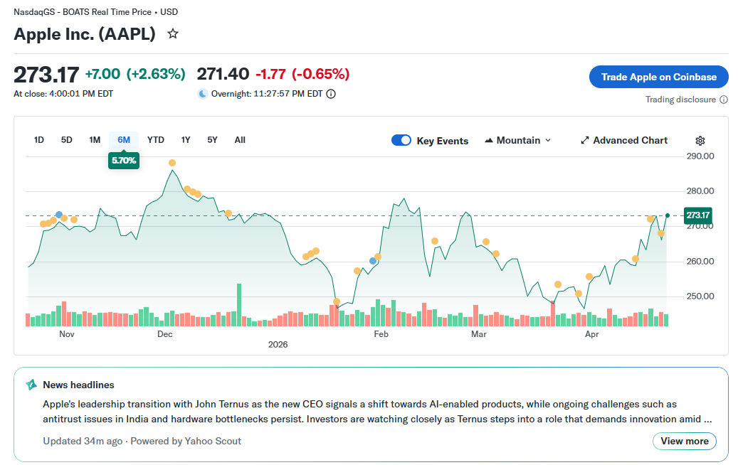
Will you participant? If yes, when?

Slide 4
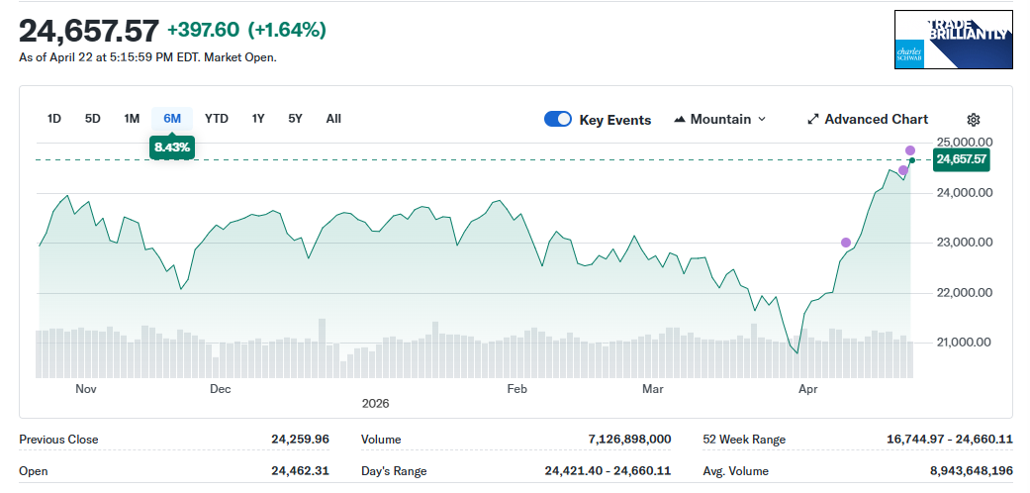
Will you participant? If yes, when?

Slide 5
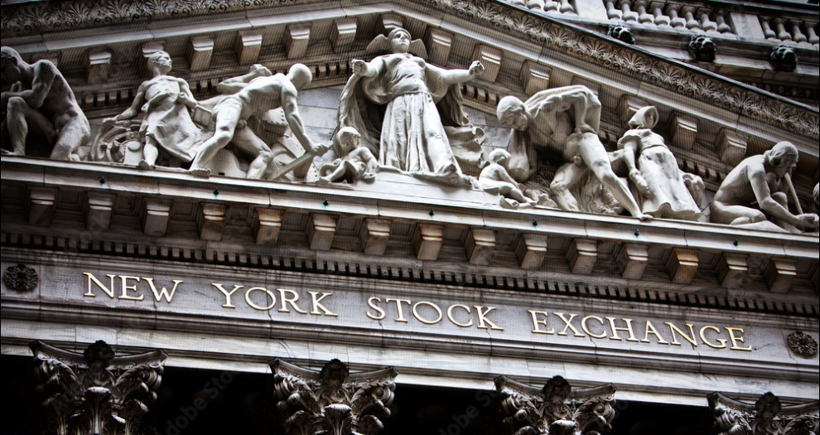
Game: Mock Exchange
Goal: Make the highest final wealth.
Setup:
3 groups, different starting positions
3 stocks, 1 share per stock only
Each round
See current prices
Discuss as a group
Buy, sell, trade, or hold
Rules
Can bid for a stock
Final wealth = cash + stock value

Slide 6
PART I
Expected utility: the rational benchmark
The classic model says an investor:
Quick example
calculates probabilities
Option A
Option B
weighs outcomes by value
$500 for sure
50% chance of $1000
chooses the option with the highest expected utility
If both options have the same expected value, the model expects stable, logical reasoning.
Shortcut translation:
“A calm calculator who makes consistent choices.”
No drama. No gut feeling. Just consistent choice.

Slide 7
PART I
But do people actually choose like that?
Expected utility assumes:
Three steps
beliefs update correctly
List the possible outcomes and probabilities
Calculate the outcomes’ expected values
Choose the option with the highest value
the same choice frame gives the same answer
emotion stays mostly in the background

Slide 8
Warm-up: test that model with your own instincts.
1
2
3
$500 for sure
or
50% chance
of $1000?
Would you accept
a 50:50 bet:
win $110 / lose $100?
After H–H–H,
what about the next
coin flip?

Slide 9
Round 1: coin flips
Live reveal
Click 1
Click 2
Click 3

Slide 10
Round 1: coin flips
Live reveal
Click 1
Click 2
Click 3

Slide 11
Round 1: coin flips
Live reveal
Click 1
Click 2
Click 3

Slide 12
Round 1: coin flips
Live reveal
Live reveal
Click 1
Click 2
Click 3
Click 1
Click 2
Click 3

Slide 13
Round 1: coin flips
Gambler’s fallacy
Live reveal
Live reveal
After a streak, people expect reversal—even when the process is still random.
“It must turn soon.”
Click 1
Click 2
Click 3
Click 1
Click 2
Click 3

Slide 14
Round 2: basketball makes
Live reveal
Make 1
Make 2
Make 3

Slide 15
Round 2: basketball makes
Live reveal
Make 1
Make 2
Make 3

Slide 16
Round 2: basketball makes
Live reveal
Make 1
Make 2
Make 3

Slide 17
Round 2: basketball makes
Live reveal
Live reveal
Make 1
Make 2
Make 3
Make 1
Make 2
Make 3

Slide 18
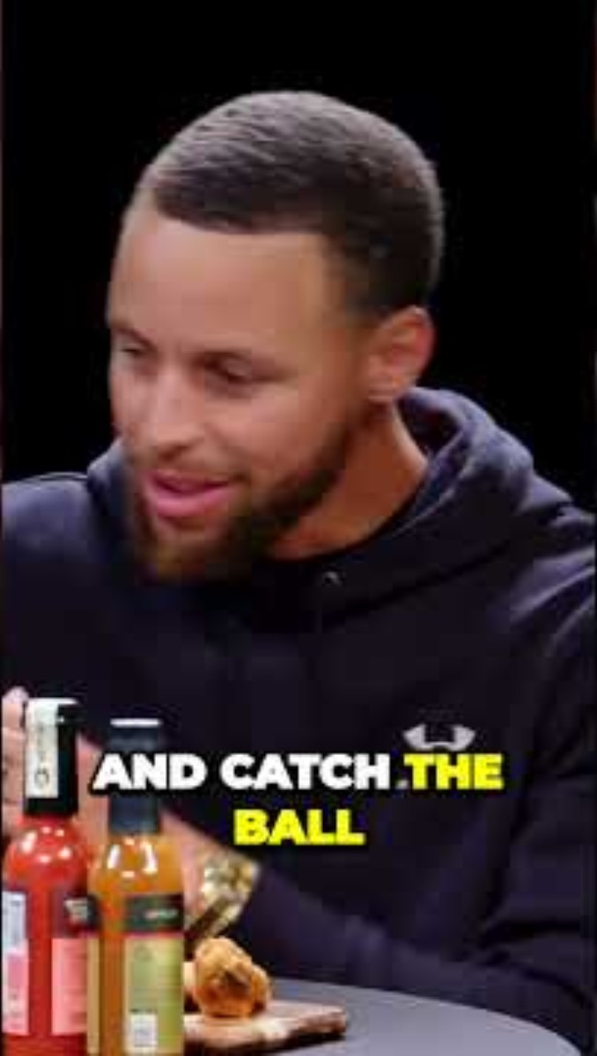
Round 2: basketball makes
Hot hand
Live reveal
Live reveal
After a streak, people expect continuation because the player or trend feels hot.
“They’re on fire.”
Make 1
Make 2
Make 3
Make 1
Make 2
Make 3

Slide 19
Round 3: a fake stock chart
Live reveal
Step 1
Step 2
Step 3

Slide 20
Round 3: a fake stock chart
Live reveal
Step 1
Step 2
Step 3

Slide 21
Round 3: a fake stock chart
Return extrapolation
Live reveal
In markets, recent winners can attract optimistic beliefs and more demand.
“The chart is telling a story.”
Step 1
Step 2
Step 3

Slide 22
Debrief: random does not feel random
Gambler’s fallacy
Hot hand
Return extrapolation
After a streak, people expect reversal—even when the process is still random.
After a streak, people expect continuation because the player or trend feels hot.
In markets, recent winners can attract optimistic beliefs and more demand.
“It must turn soon.”
“They’re on fire.”
“The chart is telling a story.”

Slide 23
One chart, two stories
Task
Make the bullish case.
Make the bearish case.
Use the same chart for both.
The point: prices do not come with built-in meaning. People add the story.

Slide 24
PART III
Activity: risk framing stations
At each station
Station 1
Station 2
Win $500 for sure
or
50% chance
Of wining $1000?
Lose $500 for sure
or
50% chance of losing $1000?
pick your choice
write your reason
Station 3
Station 4
predict what most groups will choose
5% chance of winning $1,000
vs
Win $10 for sure
50:50 bet
win $110 / lose $100

Slide 25
What did we notice? Prospect theory in plain English
Reference point
Loss aversion
Diminishing sensitivity
Probability weighting
We judge outcomes relative to where we started.
A loss usually hurts more than an equal gain feels good.
The jump from 0 to 100 feels bigger than 1100 to 1200.
Tiny probabilities can feel bigger than they really are.
Notes:
Do not explain too much between stations. Let students notice that the same class can be cautious in one frame and risk-seeking in another.

Slide 26
PART IV
Game 3: sell or hold?
Path A
Path B
buy at 10 → rise to 20 → drop to 15
buy at 10 → fall to 7 → recover to 9
Would you sell or hold? Why?
Would you sell or hold? Why?

Slide 27
Investor vs. advisor
As the investor, I would…
As the advisor, I would tell my customer…
lock in the gain
or
wait until it gets back to 10
Ignore the purchase price.
What matters now?
Why do answers change when the money feels personal?
Notes:
This is a bridge to anchoring, mental accounting, and the disposition effect.

Slide 28
What real investors often do
Disposition effect
Extrapolation
People are more likely to sell assets at gains than assets at losses.
Recent winners can attract optimistic beliefs and more demand.
Big message: human patterns are not just personal mistakes;
they can scale up into market behavior.

Slide 29
PART V
Mini market simulation
Rule
Round 1
Round 2
You only see a little recent information.
Price: 100 → 104 → 108
Headline: “This stock is the future.”
Each round, choose Buy / Sell / Hold.
Watch whether the class reacts to value, trend, or crowd energy.
Round 3
Round 4
Price: 108 → 114
Rumor: “Something may be wrong.”

Slide 30
The market moved. Did value move too?
Fundamental Value
Did the class react to fundamentals, trend, or social signals?
When did confidence spread?
When did fear spread?
Did anyone buy mainly because others seemed optimistic?
Herding
Behavioral finance asks how individual beliefs become group price movements.

Slide 31
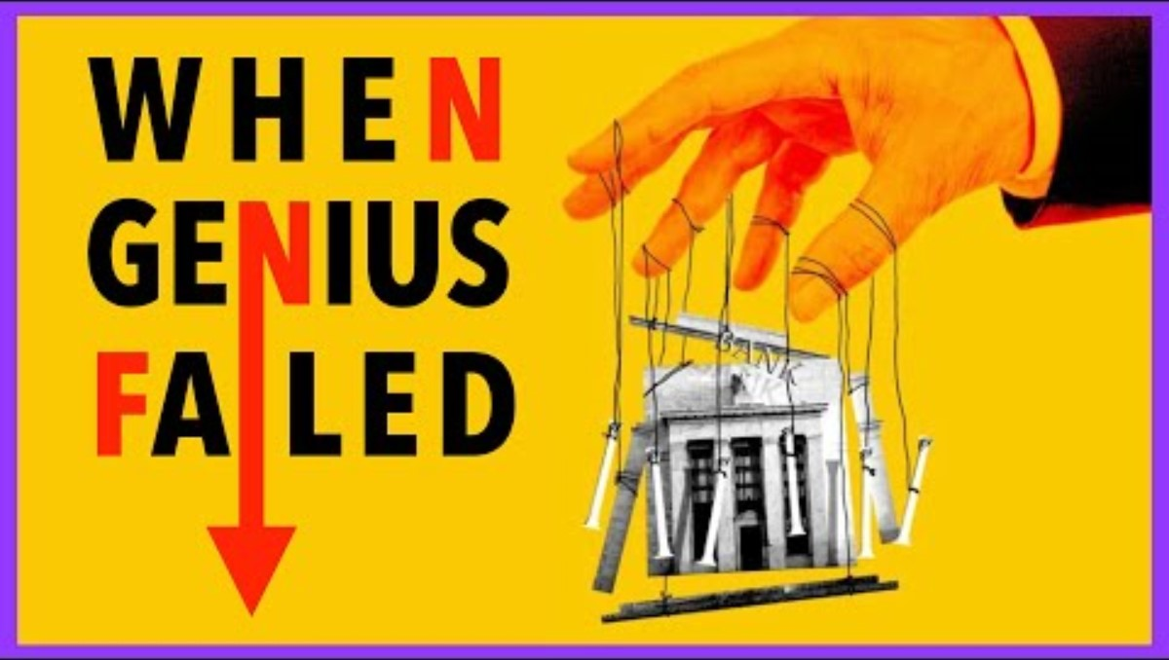
Long Term Capital Management
Notes:
This is a bridge to anchoring, mental accounting, and the disposition effect.

Slide 32
If mistakes are obvious, why doesn’t the market fix them?
1
Fundamental risk
2
Noise trader risk
Maybe the asset value really does change for good reason.
Prices can get even crazier before they calm down.
3
Horizon risk
4
Implementation costs
The correction may take too long to pay off.
Trading, shorting, and research all cost money.
Seeing a mistake is not the same as being able to profit from fixing it right away.

Slide 33
CHALLENGE
Challenge 1: which bias is this?
After three up days, an investor expects the stock to keep rising.
Extrapolation
A person refuses to sell until the stock gets back to the purchase price.
Disposition effect
A student turns down a 50:50 win $110 / lose $100 bet.
Loss aversion
A lottery-style payoff feels more attractive than the true odds justify.
Probability weighting
Someone copies others because “so many people can’t be wrong.”
Herding

Slide 34
CHALLENGE
Challenge 2: design a better decision rule
Prompt
Examples
Create one rule your group could actually use to reduce a common bias.
“Never judge a stock by only three days of movement.”
“Write a selling rule before buying.”
Write it in one sentence.
“Ask what I would tell a friend in the same situation.”
Make it specific.
“Separate what I paid from what I think it is worth now.”
Make it realistic.

Slide 35
Takeaways
Humans do not sit outside markets.
Humans are the market.

